Slide 1

MA2012 INTRODUCTION TO MECHATRONICS SYSTEMS DESIGN
Lecture 7
Prof Ang Wei Tech
College of Engineering
School of Mechanical and Aerospace Engineering

Slide 2
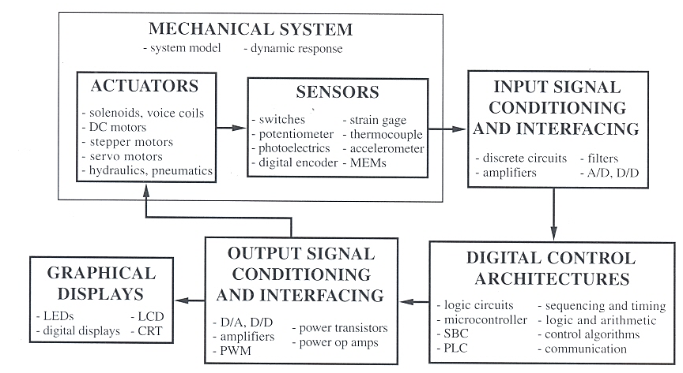
MECHATRONICS SYSTEM COMPONENTS

Slide 3
MECHATRONICS SYSTEMS DESIGN
Understand the task, define the problem
Sketch a functional block diagram
Decide & select mechatronics components (type, number, communication protocol, etc.) :
Digital control architecture
Sensors & input interfacing
Actuators & output interfacing
Display
Construct hardware prototype
Programme software / firmware

Slide 4
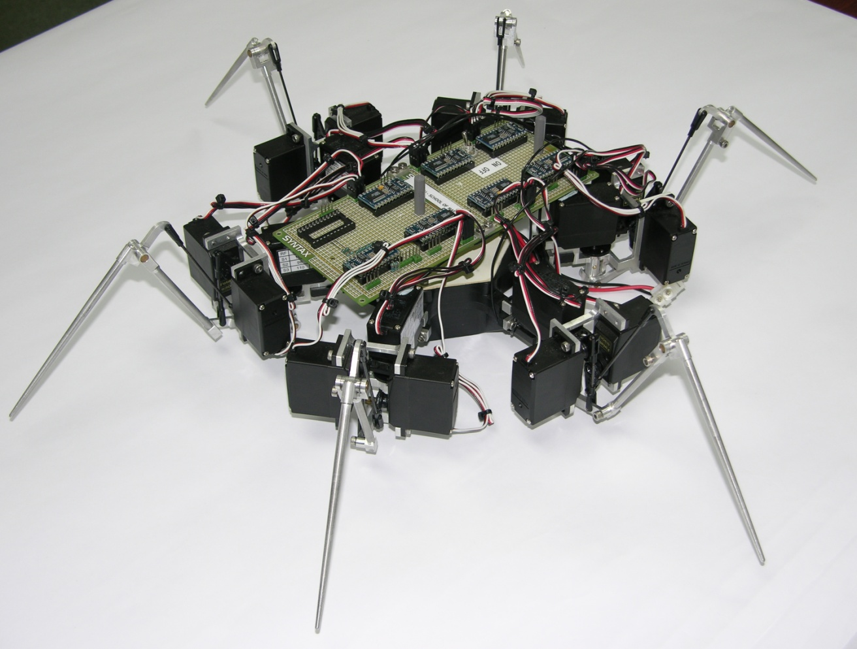
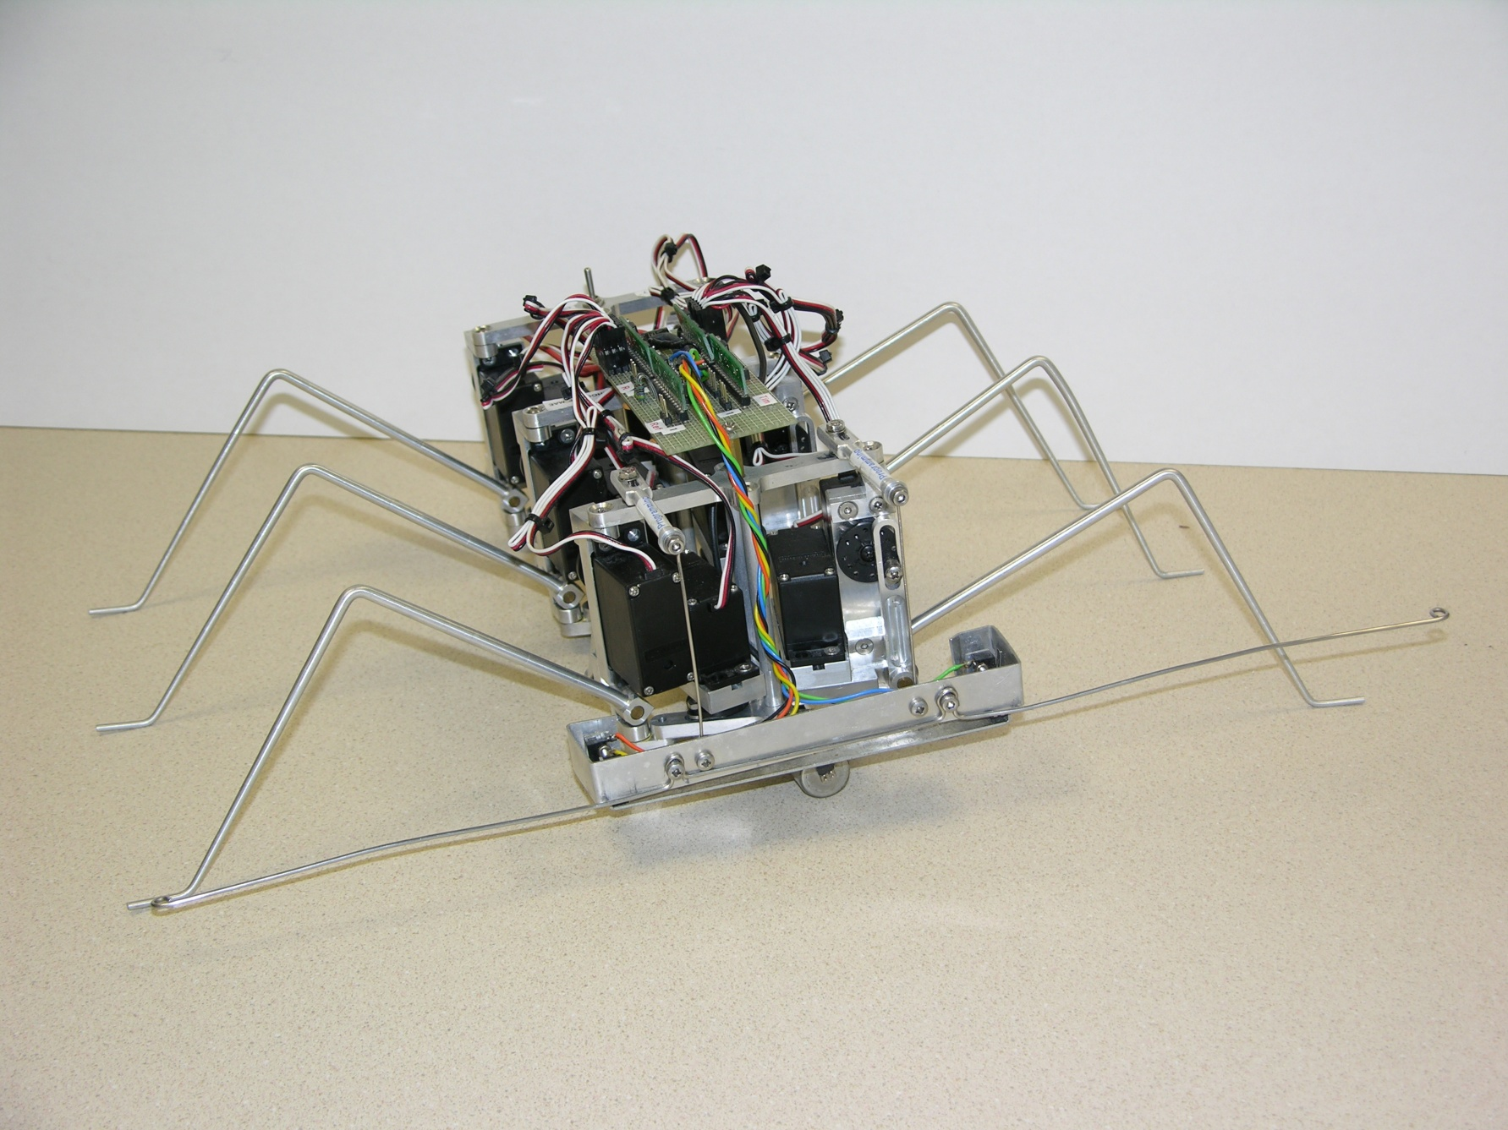
EXAMPLE: SIX-LEGGED WALKING ROBOTS
Hexapod robot with 3 DOF robot legs
Hexapod robot with 2 DOF robot legs

Slide 5
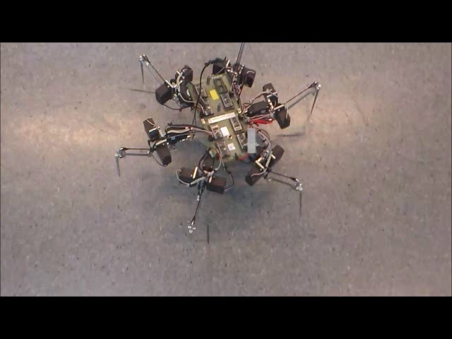
HEXAPOD ROBOT WITH 3 DOF LEGS
Click this image to play video

Slide 6
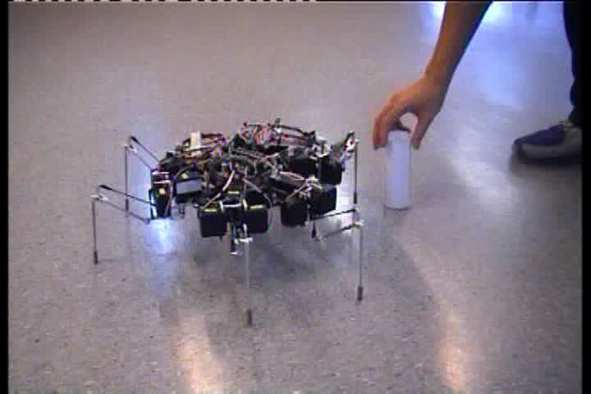
INTELLIGENT HEXAPOD ROBOT WITH 3 DOF LEGS
Click this image to play video

Slide 7
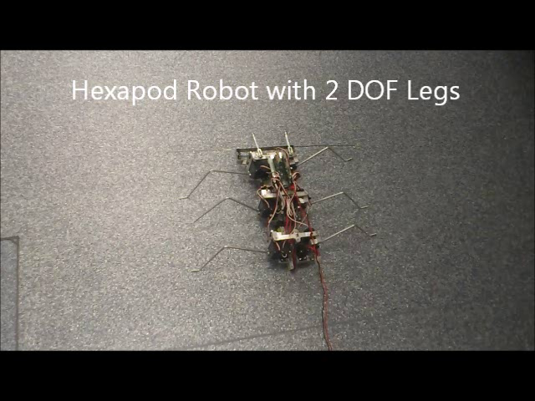
HEXAPOD ROBOT WITH 2 DOF LEGS
Click this image to play video

Slide 8
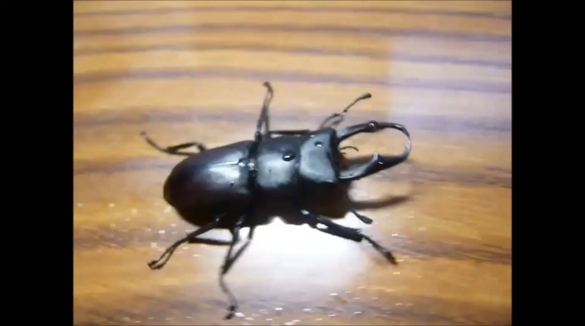
STEP 1: UNDERSTAND THE TASK, DEFINE THE PROBLEM
How does a beetle walk with 6 legs?
Click this image to play video

Slide 9
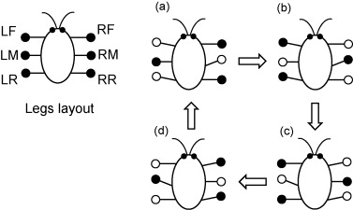
STEP 1: UNDERSTAND THE TASK, DEFINE THE PROBLEM
Tripod Gait
LB
RB

Slide 10
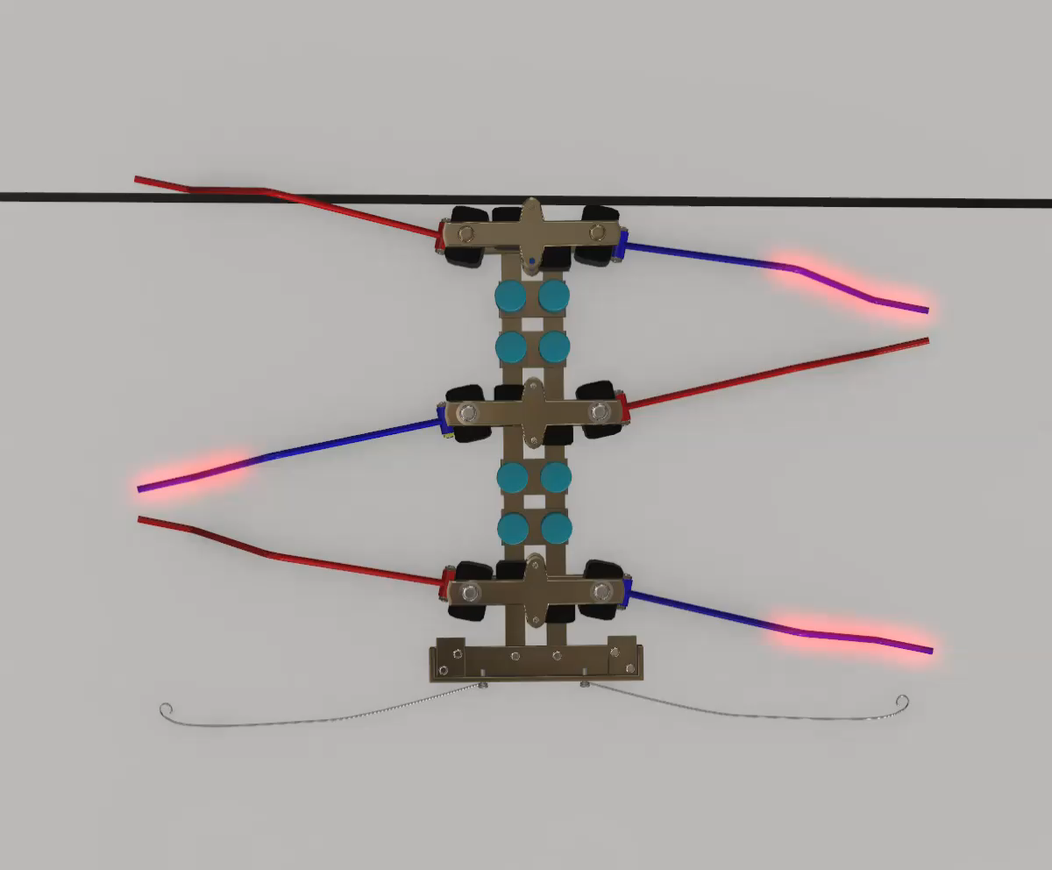
STEP 1: UNDERSTAND THE TASK, DEFINE THE PROBLEM
Tripod Gait
Click this image to play animation

Slide 11
STEP 1: UNDERSTAND THE TASK, DEFINE THE PROBLEM
L Whisker
R Whisker
LF Leg
RF Leg
LFH
RFH
LFV
RFV
LM Leg
LMH
RMH
RM Leg
LMV
RMV
LB Leg
LBH
RBH
RB Leg
LBV
RBV

Slide 12
STEP 1: UNDERSTAND THE TASK, DEFINE THE PROBLEM
Leg Actuation Method
Horizontal servo rotates about the vertical axis
Vertical servo rotates about the horizontal axis
Vertical servo drives the leg up & down
A single 2 DOF leg
Forward direction
Horizontal servo drives the leg forward & backward

Slide 13
STEP 1: UNDERSTAND THE TASK, DEFINE THE PROBLEM
Leg tip locus
Triangle profile passing through 4 nodes: a, b, c & d
Forward (CCW): a-b-c-d-a-…
Backward (CW): a-d-c-b-a-…
Time per stage, t = n s
Time per cycle, T = 4n s
Reference: LF Leg
c
n
n
CCW
ground
d
b
n
a
n

Slide 14
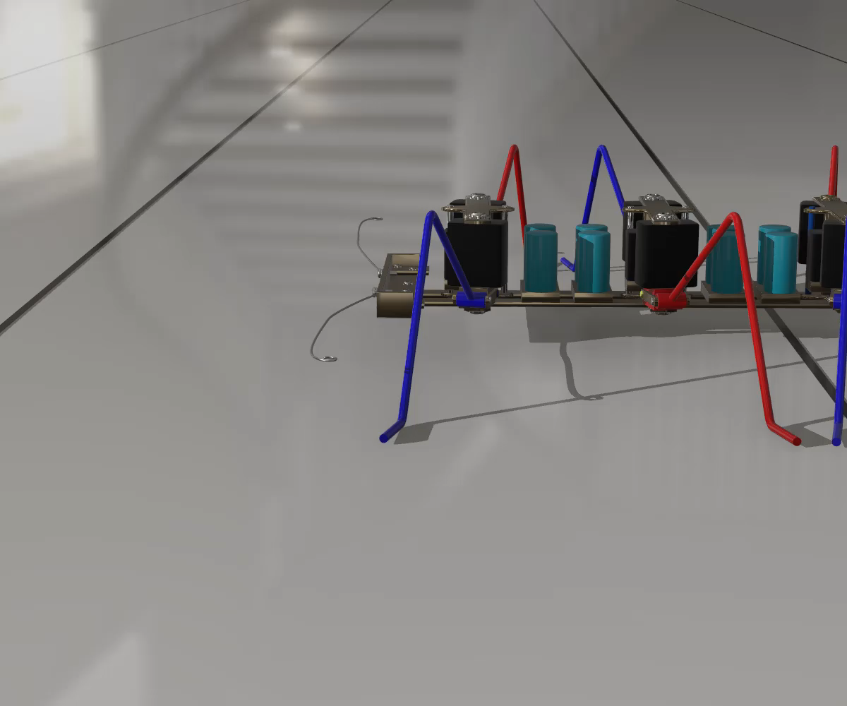
STEP 1: UNDERSTAND THE TASK, DEFINE THE PROBLEM
Click this image to play animation

Slide 15
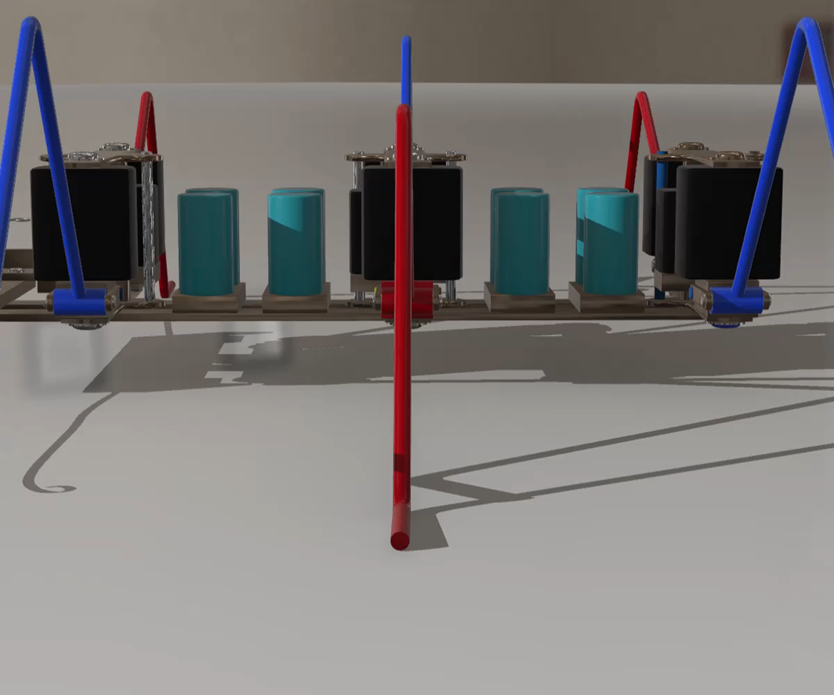
STEP 1: UNDERSTAND THE TASK, DEFINE THE PROBLEM
c
d
a
b

Slide 16
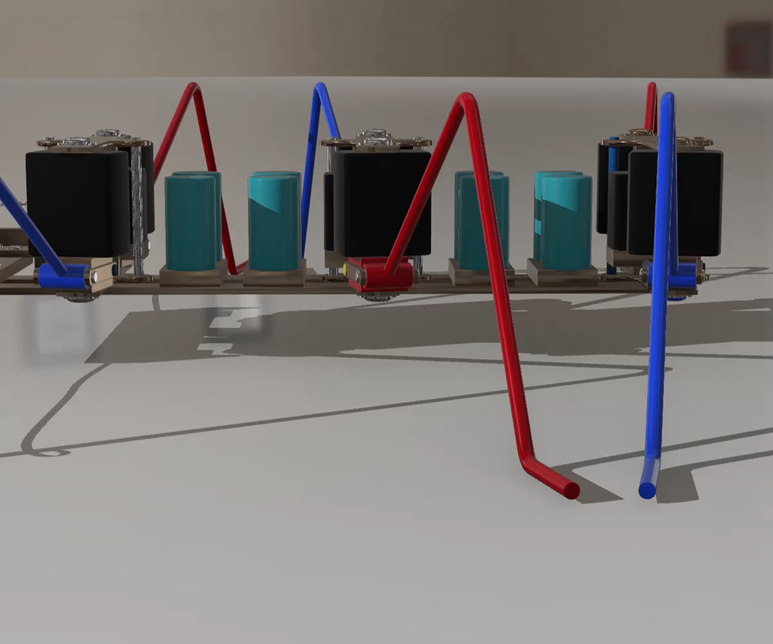
STEP 1: UNDERSTAND THE TASK, DEFINE THE PROBLEM
c
d
a
b

Slide 17
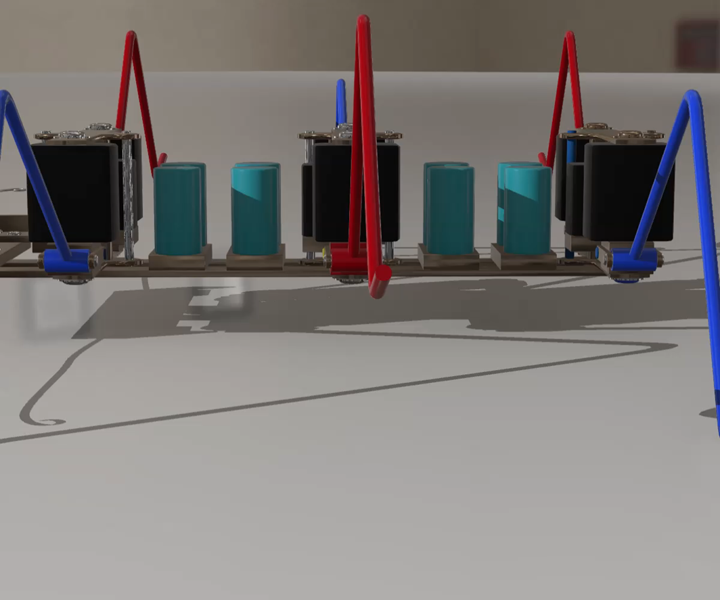
STEP 1: UNDERSTAND THE TASK, DEFINE THE PROBLEM
c
d
a
b

Slide 18
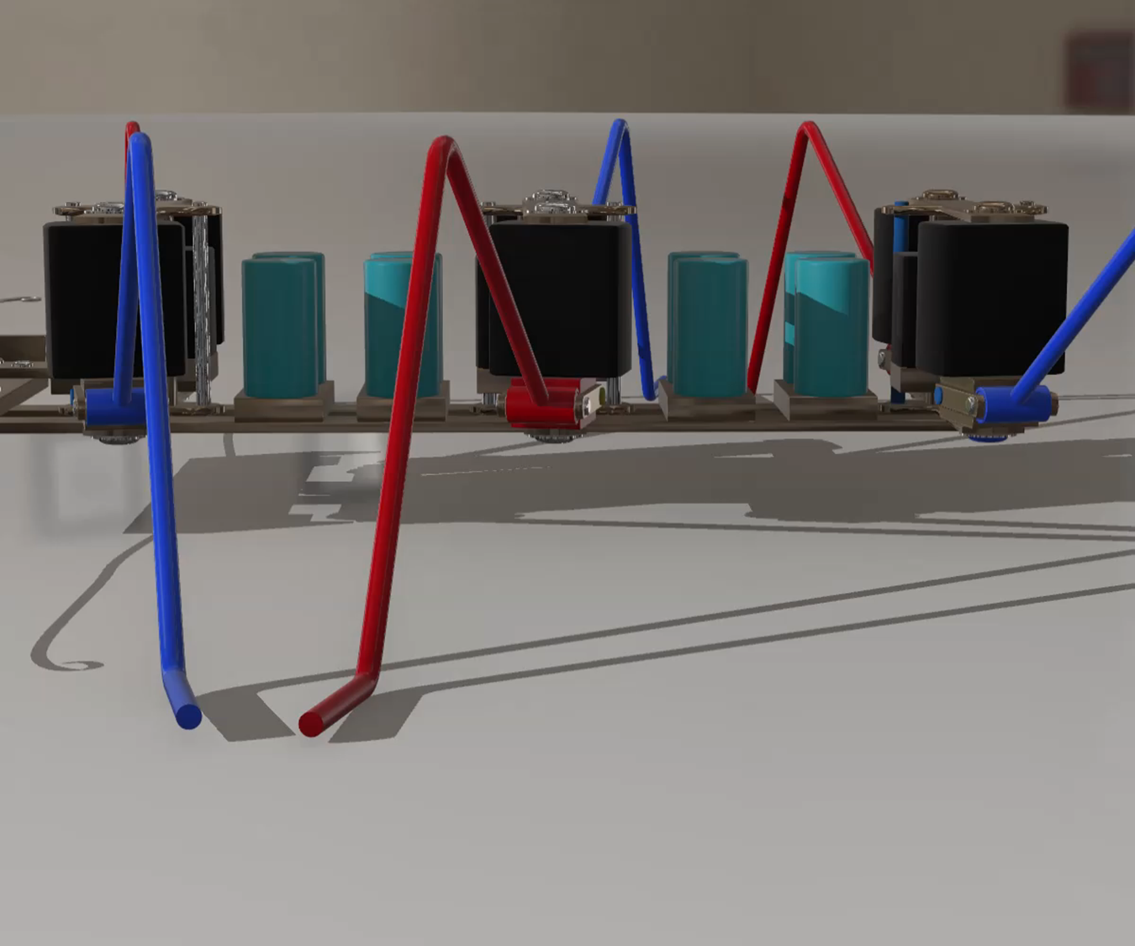
STEP 1: UNDERSTAND THE TASK, DEFINE THE PROBLEM
c
d
a
b

Slide 19
STEP 1: UNDERSTAND THE TASK, DEFINE THE PROBLEM
c
d
a
b

Slide 20
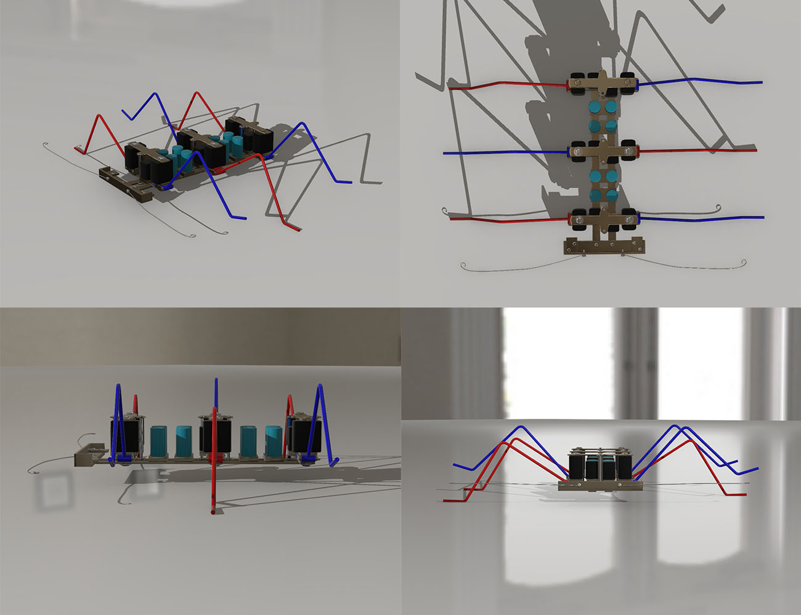
STEP 1: UNDERSTAND THE TASK, DEFINE THE PROBLEM

Slide 21
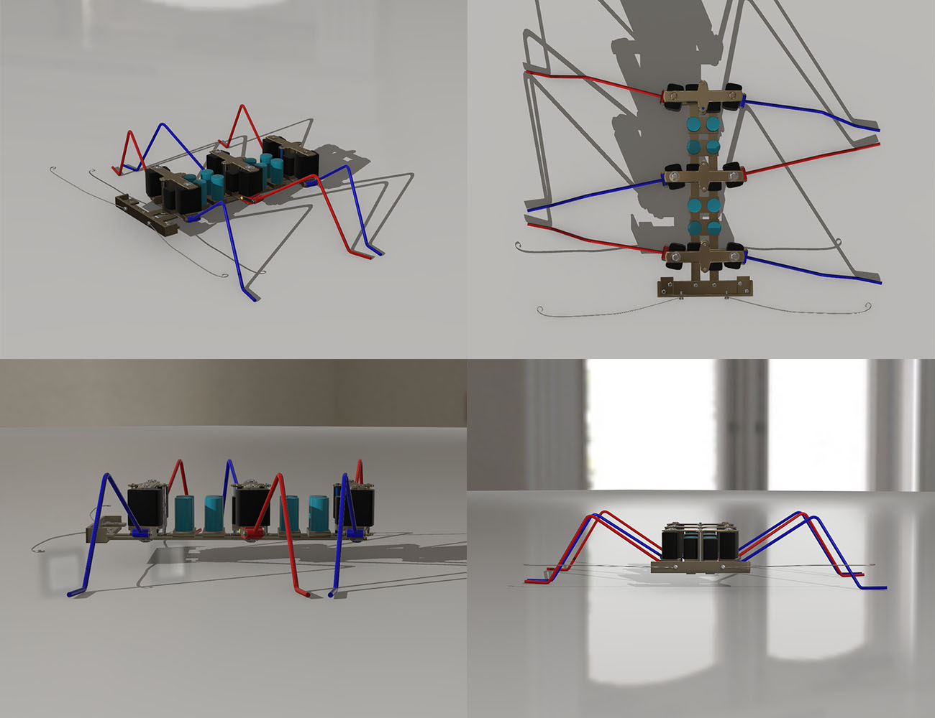
STEP 1: UNDERSTAND THE TASK, DEFINE THE PROBLEM

Slide 22

STEP 1: UNDERSTAND THE TASK, DEFINE THE PROBLEM

Slide 23
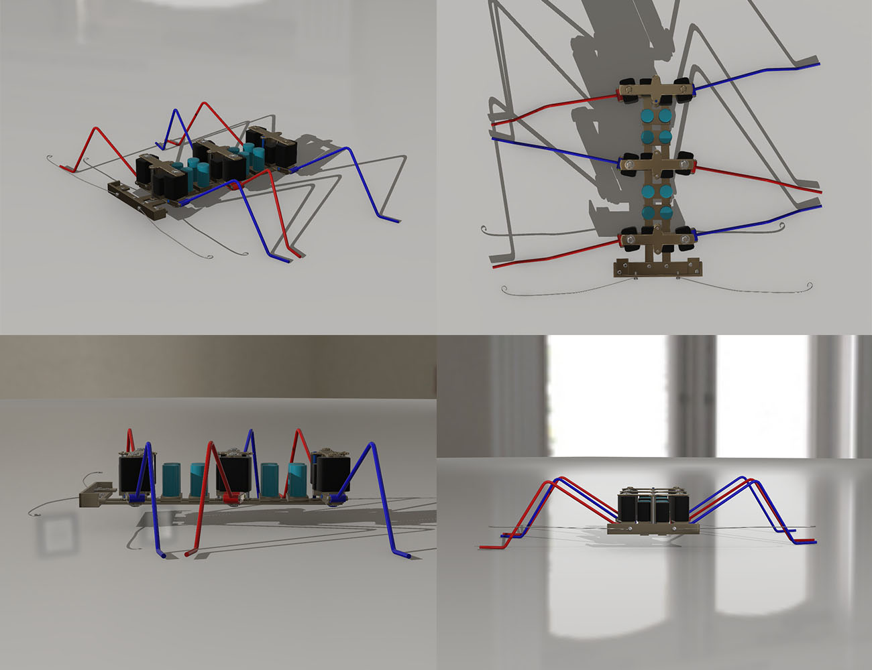
STEP 1: UNDERSTAND THE TASK, DEFINE THE PROBLEM

Slide 24
STEP 1: UNDERSTAND THE TASK, DEFINE THE PROBLEM

Slide 25
STEP 1: UNDERSTAND THE TASK, DEFINE THE PROBLEM
Tripod Gait Cycle
LB
RB
\ Time Leg \ | n | 2n | 3n | 4n | 5n | Comment
LF | a | b | c | d | a | Phase = 0°
RM
LB
RF | c | d | a | b | c | Phase = 180°
LM
RB

Slide 26
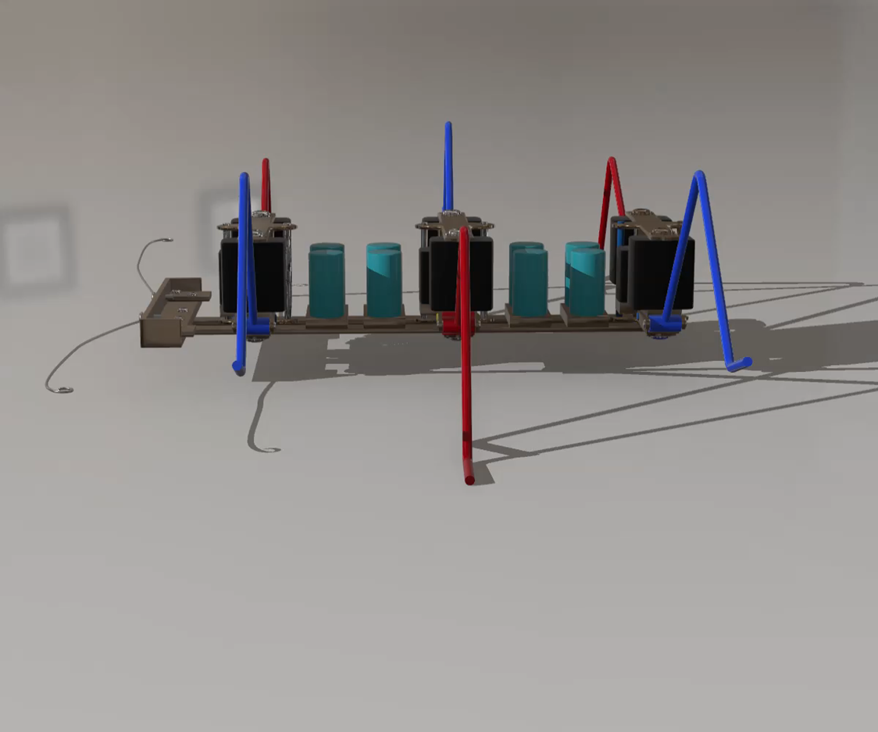
STEP 1: UNDERSTAND THE TASK, DEFINE THE PROBLEM
c
c
d
a
b
d
a
b

Slide 27
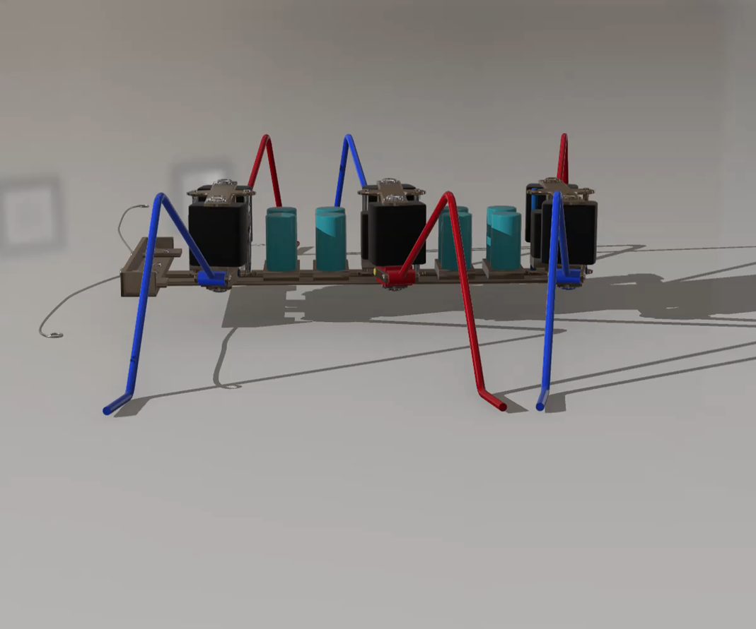
STEP 1: UNDERSTAND THE TASK, DEFINE THE PROBLEM
c
c
d
a
b
d
a
b

Slide 28
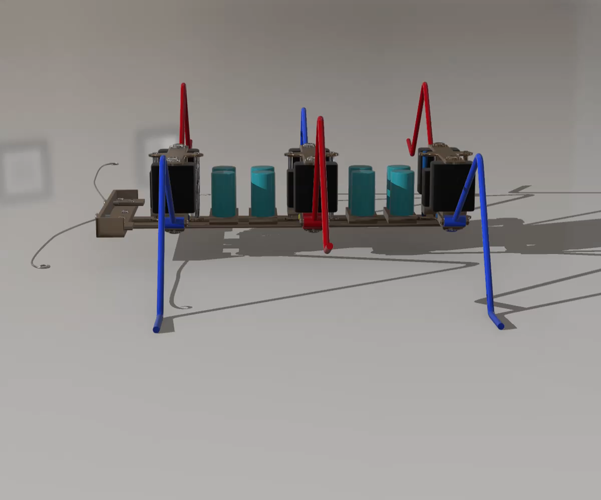
STEP 1: UNDERSTAND THE TASK, DEFINE THE PROBLEM
c
c
d
a
b
d
a
b

Slide 29
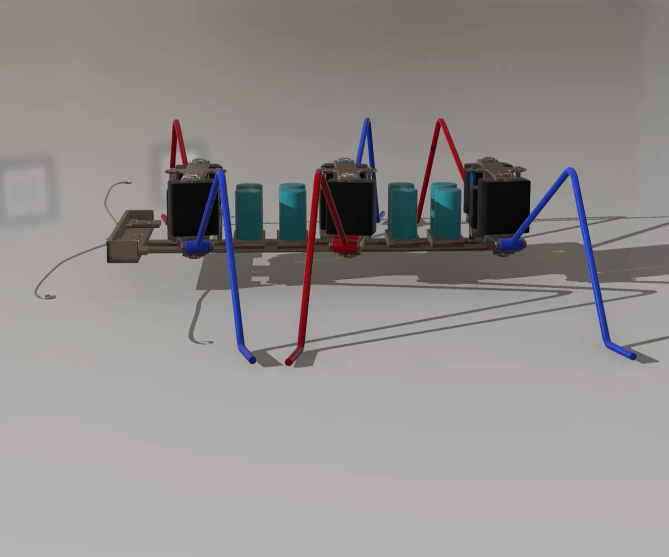
STEP 1: UNDERSTAND THE TASK, DEFINE THE PROBLEM
c
c
d
a
b
d
a
b

Slide 30
STEP 1: UNDERSTAND THE TASK, DEFINE THE PROBLEM
c
c
d
a
b
d
a
b

Slide 31
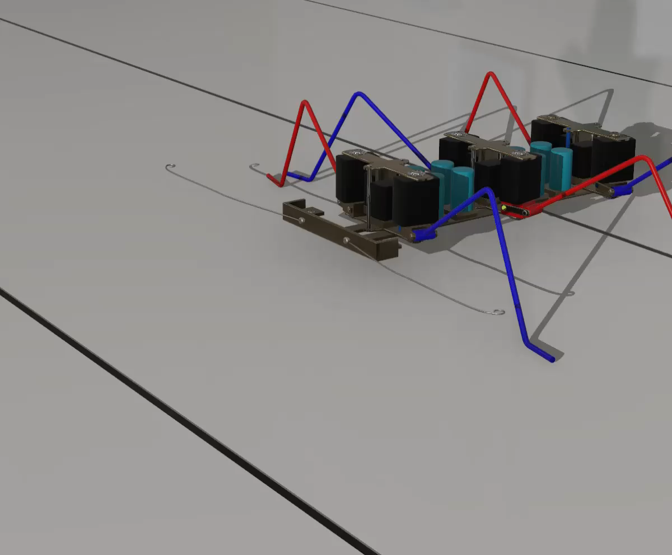
STEP 1: UNDERSTAND THE TASK, DEFINE THE PROBLEM
Click this image to play animation

Slide 32
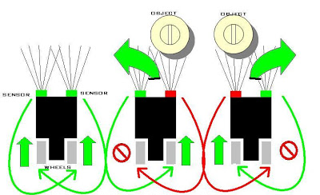
STEP 1: UNDERSTAND THE TASK, DEFINE THE PROBLEM
Obstacle avoidance
Contact or non-contact sensors
Avoidance strategy

Slide 33
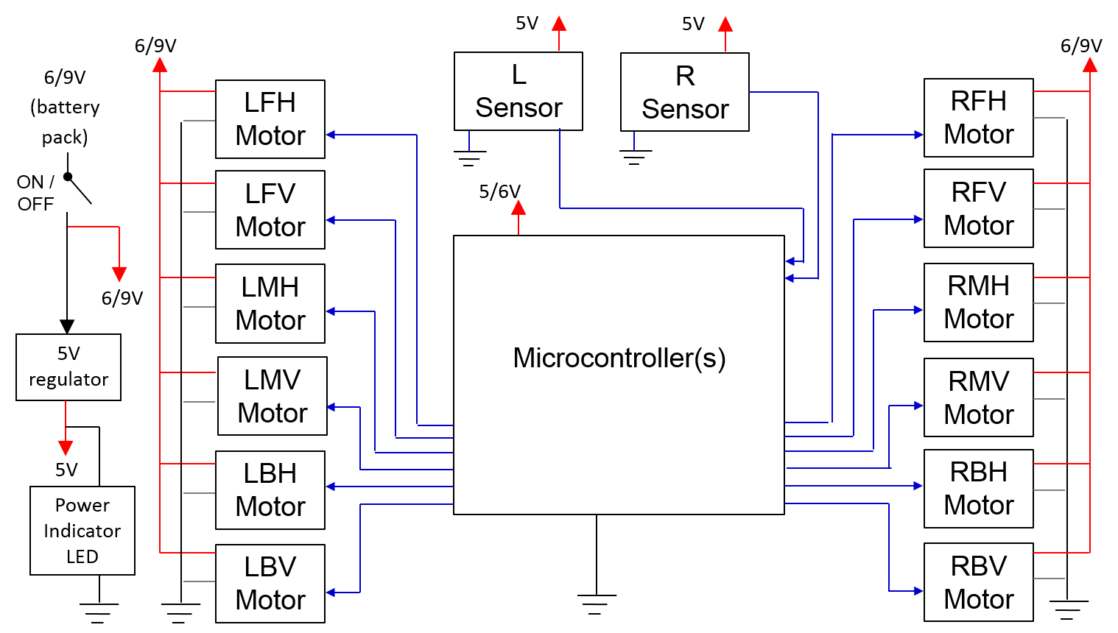
STEP 2: SKETCH A FUNCTIONAL BLOCK DIAGRAM

Slide 34
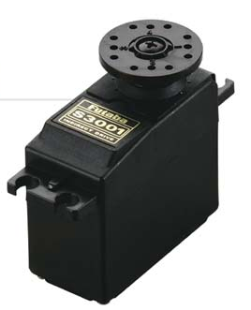

STEP 3: DECIDE & SELECT MECHATRONICS COMPONENTS
Actuators: Servo x 12
The drive flange can rotate ½ revolution
It is driven by width of high pulse (Logic 1) called ‘Mark’ length
-90° to +90°
Mark
Space

Slide 35
STEP 3: DECIDE & SELECT MECHATRONICS COMPONENTS
Actuators: Servo
Drive Flange
+5V
Potentiometer
-90° to +90°
This voltage represents the actual angle of the drive flange
Speed reduction (200:1) gearbox
0V
+6V
_
+6V
Signal
Error
DC
Motor
+
Amplifier
0V
This voltage represents the desired angle of the drive flange
This voltage represents the difference between the desired and actual angle of the drive flange
0V

Slide 36
STEP 3: DECIDE & SELECT MECHATRONICS COMPONENTS
Drive flange rotation (°)
180
135
Safe range
90
45
Mark Length (ms)
0
0.5
1.0
1.5
2.0
2.5

Slide 37
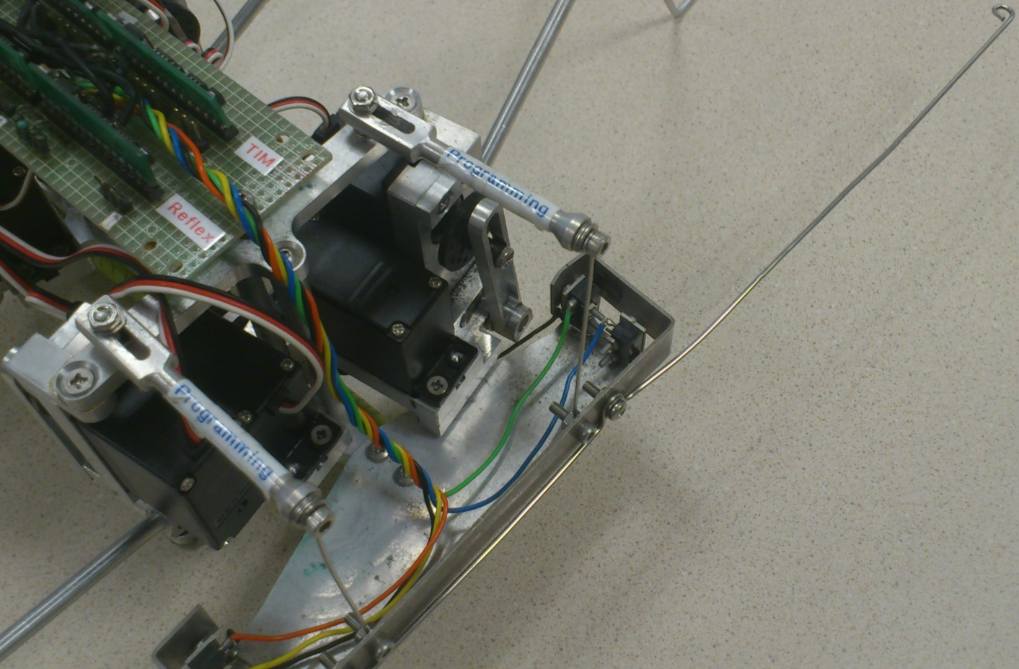
STEP 3: DECIDE & SELECT MECHATRONICS COMPONENTS
Sensors: Limit Switch (contact sensor) x 2

Slide 38
STEP 3: DECIDE & SELECT MECHATRONICS COMPONENTS
Control Architecture: Basic Stamp BS1 x 4
6V DC
Power Supply
5V Regulator
Program from PC via downloading cable
Rewritable, non-volatile memory, like a hard disk drive
EEPROM – for storing your program
The brain of the microcontroller
Microprocessor
+ I/O
8 I/O Pins
Scratch-pad memory for variables, e.g. i, j.
These memory contents are lost when power is switched off
RAM – for storing the variables

Slide 39
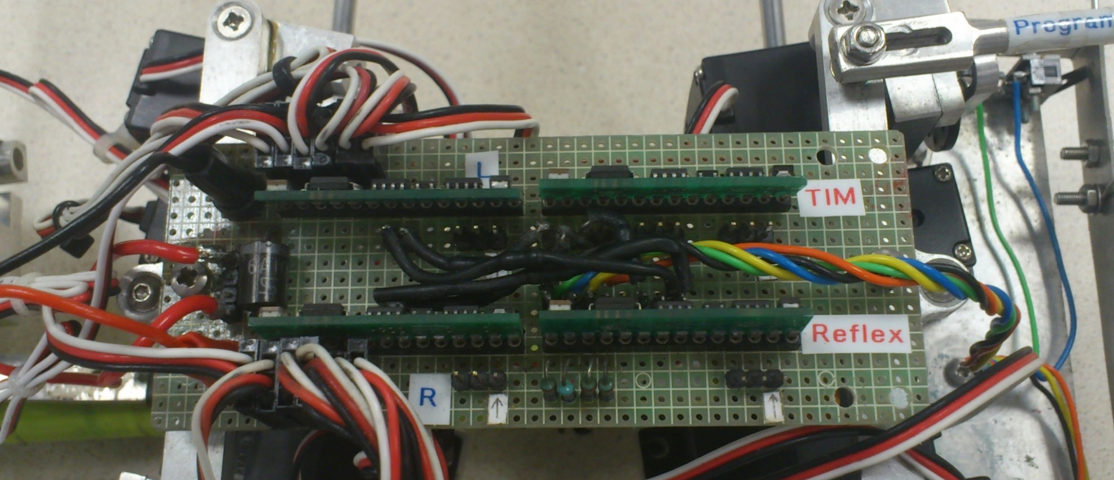
STEP 4: CONSTRUCT HARDWARE PROTOTYPE
Control circuit PCB

Slide 40
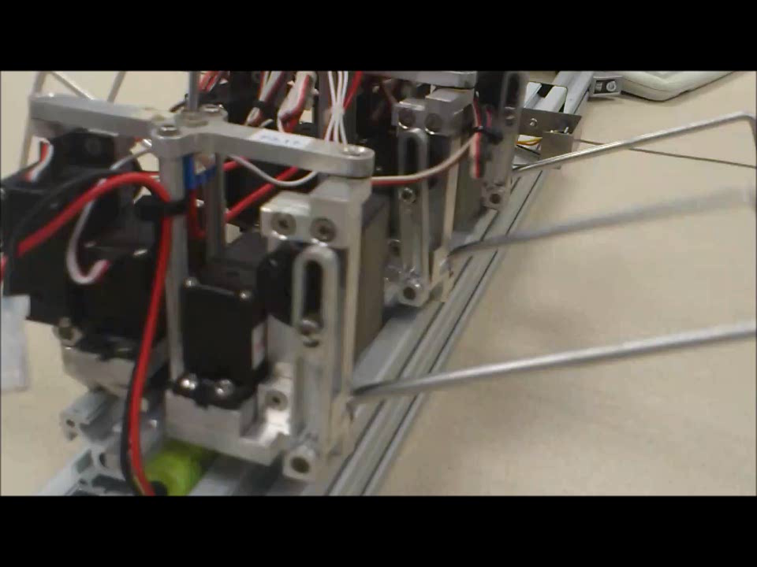
STEP 4: CONSTRUCT HARDWARE PROTOTYPE
2 DOF Leg Mechanism
Click this image to play video

Slide 41
STEP 5: PROGRAMMING
Basic Stamp #1: Timing Controller
To send timing pulses to all other Basic Stamps to synchronize the movement of the legs:
Home pulse (100μs) + 39 thin pulses (20μs) at intervals of 20 ms over a period of 800 ms
Update frequency = 50 Hz
P5
Basic Stamp BS#4
BS#1
Timing Controller
P2
P6
P7
Basic Stamp BS#2
Basic Stamp BS#3
P0
P0

Slide 42
STEP 5: PROGRAMMING
Basic Stamp #1: Timing Controller
39 thin pulses
Repeat
Home pulse
//
100 μs
20 μs
20 μs
20 μs
20 μs
100 μs
P6 & P7
0
1
2
38
39
//
20 ms
20 ms
20 ms
20 ms
P5
//
100 μs
20
100 μs
Up
21
19
Period per interval = 20 ms
Period per stage, t = 200 ms
Period per cycle, T = 800 ms
22
18
23
17
Forward
Backward
24
16
25
15
Down
26
Leg tip locus (forward)
14
27
13
28
12
29
11
30
Home pulse
ground
10
31 32 33 34 35 36 37 38 39 0 1 2 3 4 5 6 7 8 9

Slide 43
STEP 5: PROGRAMMING
BS#2 & #3: L & R Leg Controllers
Control 6 servos each (P2-7)
Receives timing from BS#1 (P0) & direction from BS#4 (P1)
LFH Servo
RFH Servo
LFV Servo
Basic Stamp BS#1
Basic Stamp BS#4
RFV Servo
LMH Servo
RMH Servo
LMV Servo
Basic Stamp BS#2
Basic Stamp BS#3
RMV Servo
LBH Servo
RBH Servo
LBV Servo
RBV Servo

Slide 44
STEP 5: PROGRAMMING
Basic Stamp #2 & #3:
Group 1 Legs
Left & Right Legs Controllers
LB
RB
LFH = LBH = 150
LFV = LBV = 100
20
Mark length
21
19
LFH = LBH = 125
LFV = LBV = 150
22
c
18
23
17
24
16
25
15
26
Forward: a-b-c-d-a
Backward: a-d-c-b-a
14
27
13
28
12
29
a
11
30
10
d
31 32 33 34 35 36 37 38 39 0 1 2 3 4 5 6 7 8 9
b
LFH = LBH = 100
LFV = LBV = 200
LFH = LBH = 150
LFV = LBV = 200
LFH = LBH = 200
LFV = LBV = 200

Slide 45
STEP 5: PROGRAMMING
Basic Stamp #2 & #3: Left & Right Legs Controllers
Movement of Group 2 Legs is 180° phase offset from Group 1
Group 2 Legs
LMH = 150
LMV = 100
LB
RB
0
39
1
2
c
38
3
37
4
36
5
35
6
Forward: c-d-a-b-c
Backward: c-b-a-d-c
34
7
33
8
32
9
a
31
10
30
d
11 12 13 14 15 16 17 18 19 20 21 22 23 24 25 26 27 28 29
b
LMH = 100
LMV = 200
LMH = 150
LMV = 200
LMH = 200
LMV = 200

Slide 46
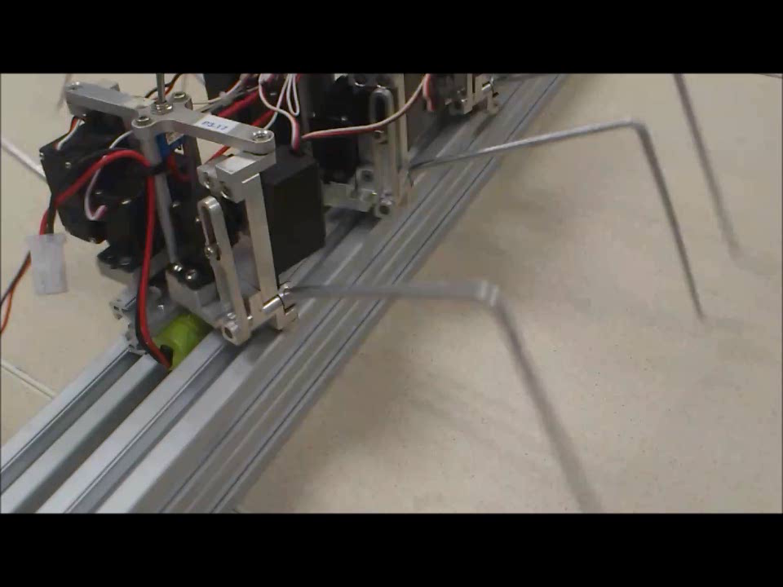
TRIPOD GAIT
Click this image to play video

Slide 47
STEP 5: PROGRAMMING
Basic Stamp #2 & #3: Left & Right Legs Controllers - Rotate Right:
Left legs forward
Right legs backward
c
LB
RB
20
19
21
22
18
23
17
24
LM: c-d-a-b-c
LF & LB: a-b-c-d-a
RM: a-d-c-b-a
RF & RB: c-b-a-d-c
16
25
15
26
14
27
13
28
12
29
11
30
10
d
31 32 33 34 35 36 37 38 39 0 1 2 3 4 5 6 7 8 9
b
a

Slide 48
STEP 5: PROGRAMMING
Basic Stamp #2 & #3: Left & Right Legs Controllers - Rotate Left:
Left legs backward
Right legs forward
c
LB
RB
20
19
21
22
18
23
17
24
LM: c-b-a-d-c
LF & LB: a-d-c-b-a
RM: a-b-c-d-a
RF & RB: c-d-a-b-c
16
25
15
26
14
27
13
28
12
29
11
30
10
d
31 32 33 34 35 36 37 38 39 0 1 2 3 4 5 6 7 8 9
b
a

Slide 49
STEP 5: PROGRAMMING
Basic Stamp #4: Reflex Controller
BS#4 receives a LOW (0) when Left & Right Whisker limit switches are closed
BS#4 sends signals to P0 & P1 of BS#2 & BS#3 respectively to control forward / backward directions:
LOW(0)–backward; HIGH(1)-forward
P0=0 & P1=1: Rotate Right
P0=1 & P0=0: Rotate Left
5V
4.7kΩ
4.7kΩ
L Whisker limit switch
R Whisker limit switch
Basic Stamp BS#1
Basic Stamp BS#4
Basic Stamp BS#2
Basic Stamp BS#3

Slide 50
STEP 5: PROGRAMMING
Basic Stamp #4: Reflex Controller
Obstacle avoidance strategy:
If Right Whisker limit switch activated
Go backward (P0 = P1 = 0) for 3 cycles (BS#2 & BS#3 receive Home pulse 3 times)
Rotate left (P0 = 1, P1 = 0) for 2 cycles
Go forward (P0 = P1 = 1)
If Left Whisker limit switch activated
Go backward (P0 = P1 = 0) for 3 cycles
Rotate right (P0 = 0, P1 = 1) for 2 cycles
Go forward (P0 = P1 = 1)

Slide 51
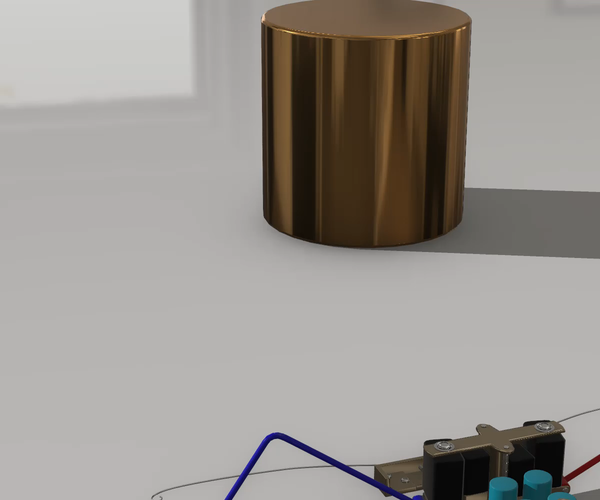
OBSTACLE AVOIDANCE
Click this image to play animation

Slide 52
A COMPLETE BLOCK DIAGRAM
5V
4.7kΩ
4.7kΩ
6V
L Whisker limit switch
6V
6V (battery pack)
LFH Servo
R Whisker limit switch
RFH Servo
LFV Servo
Basic Stamp BS#1
Basic Stamp BS#4
RFV Servo
5V regulator
6V
LMH Servo
RMH Servo
ON /OFF
LMV Servo
Basic Stamp BS#2
Basic Stamp BS#3
RMV Servo
5V
Power Indicator LED
LBH Servo
RBH Servo
LBV Servo
RBV Servo

Slide 53
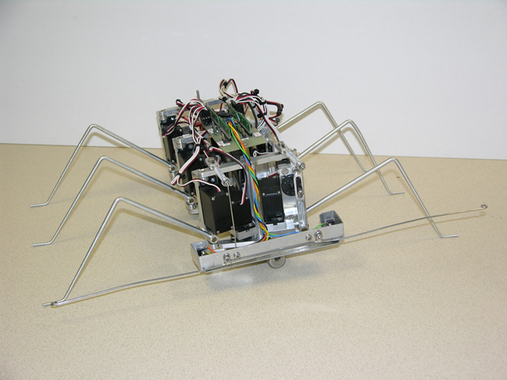
REDESIGN THE CONTROL ARCHITECTURE WITH ARDUINO UNO MCU
How many pieces of Arduino UNO MCU would be needed for this application?
1
2
3
4

Slide 54

FUNCTIONAL BLOCK DIAGRAM

Slide 55
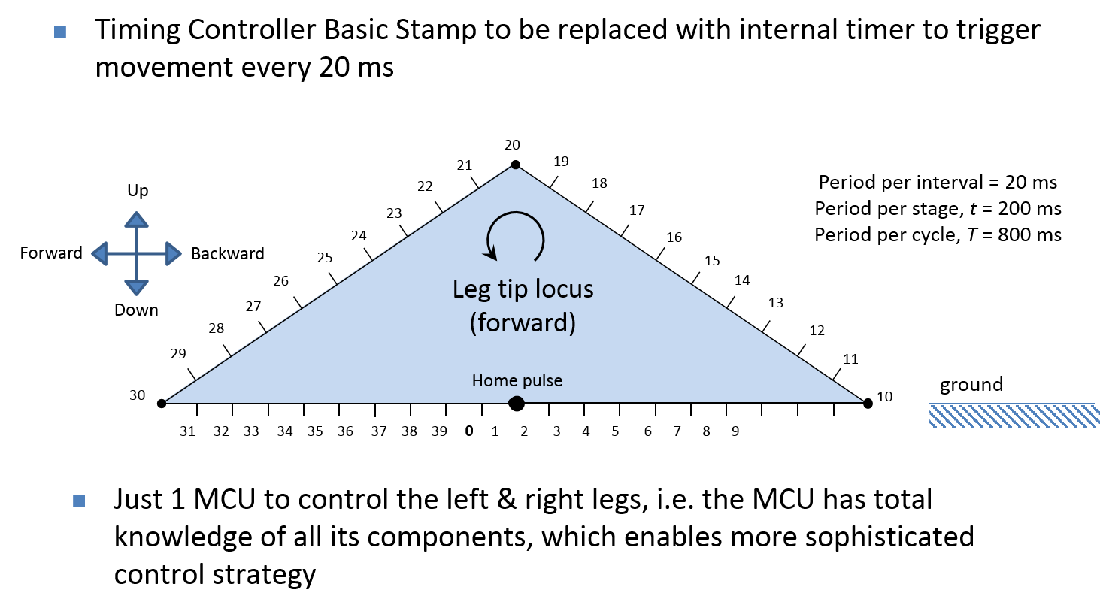
PROGRAMMING

Slide 56
HEXAPOD ROBOT WITH 2 DOF LEGS
Click this image to play video

Slide 57
SUMMARY: MECHATRONICS SYSTEMS DESIGN
Understand the task, define the problem
Sketch a functional block diagram
Decide & select mechatronics components (type, number, communication protocol, etc.) :
Digital control architecture
Sensors & input interfacing
Actuators & output interfacing
Display
Construct hardware prototype
Programme software / firmware

